Slide 1

Basic Details of the Team and Problem Statement
Ministry/Organization Name/Student Innovation: AICTE, MIC-Student Innovation
PS Code: SIH1587
Problem Statement Title: Student Innovation
Team Name: Ctrl+C/Ctrl+V
Team Leader Name: Kshitij Chaturvedi
Institute Code (AISHE):
Institute Name: Dr. Akhilesh Das Gupta Institute of Professional Studies
Theme Name: Disaster Management

Slide 2
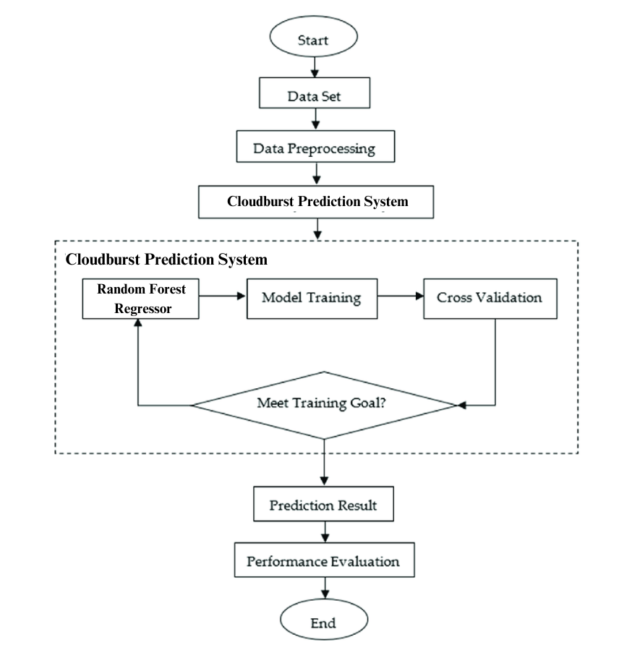
Idea/Approach Details
Objective: Early prediction and mitigation of cloudburst events.
Importance: Reducing the impact of cloudbursts on communities and infrastructure.
Key Features: Real-time Data Integration, Alert System for Authorities, Deep Learning Integration for more refined results

Slide 3
Idea/Approach Details
Technology stack
Machine Learning: Random Forest Regressor
Data Sources: Open-METEO, Google Earth Engine, Indian Meteorological Department
Programming Languages: Python, JavaScript.
Libraries and Frameworks: TensorFlow, scikit-learn, Streamlit (prototype), React
Visualization: Matplotlib, Seaborn, Google Earth Engine.
Use Cases
Early Warning System: Alerting authorities and communities about potential cloudburst events.
Infrastructure Protection: Safeguarding critical infrastructure.
Agriculture: Helping farmers mitigate crop damage.
Search and Rescue: Optimizing rescue operations.
Disaster Preparedness Training: Educational purposes.
Insurance Risk Assessment: Enhanced risk evaluation for insurers.
Future Scope
Real-time Prediction & Alerts: Immediate alerts for authorities and communities.
Web Application/Web Extension/Mobile Application: User-friendly interfaces for accessing predictions.
Alerts for Heavy Rainfall: Expanding the scope to include heavy rainfall alerts.
Multiple Dataset Integration: Incorporating diverse datasets for more accurate predictions.

Slide 4
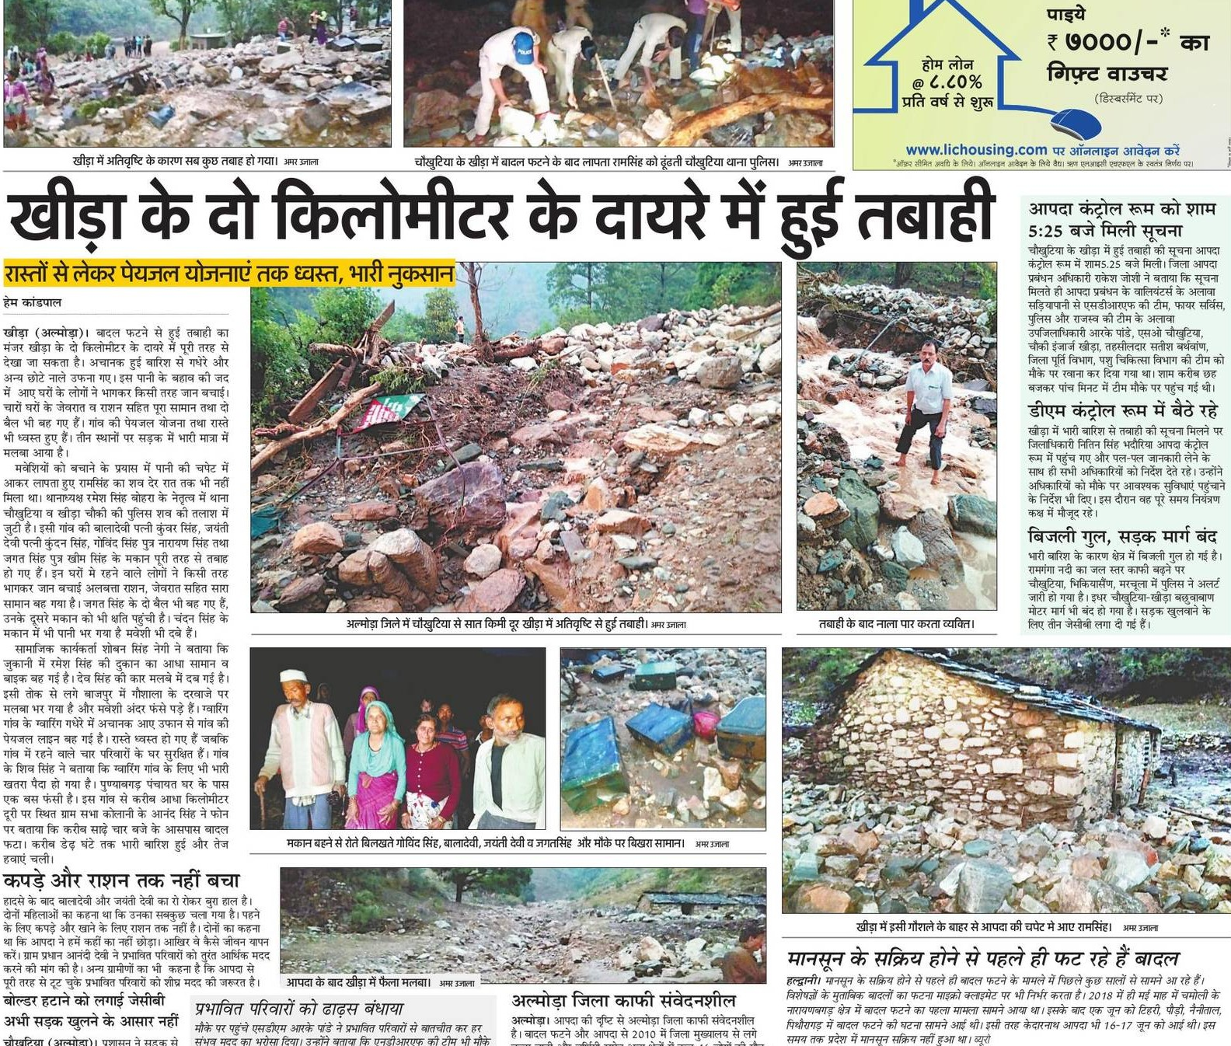
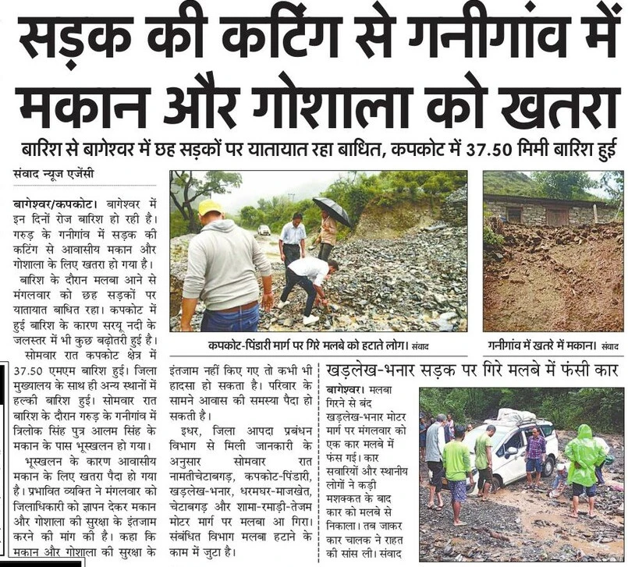
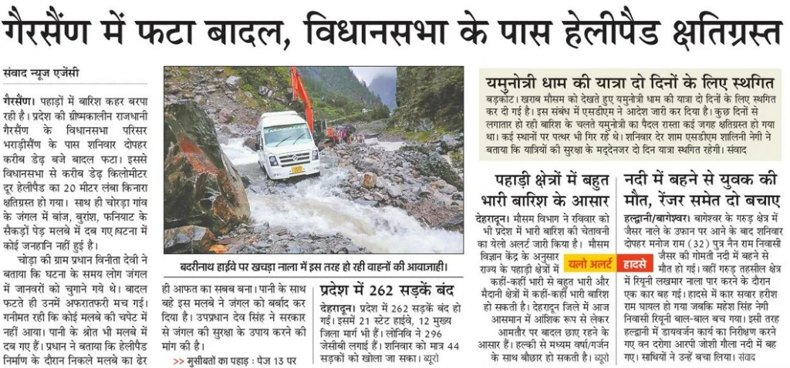
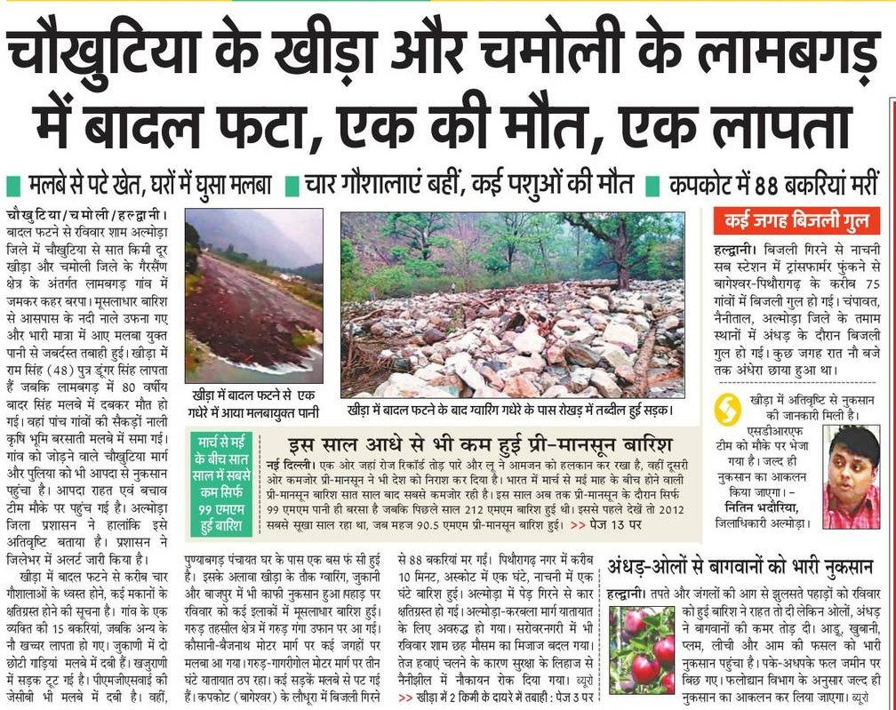
About Cloudbursts
Since the onset of the monsoon on June 24, Himachal Pradesh has suffered losses amounting to over ₹5,361 crore
in 2022, a cloudburst triggered flash floods during an annual Amarnath Yatra in Kashmir, leaving at least 16 people dead.
Leh Cloudburst (2010)
Kedarnath Cloudburst and Flood (2013)
Uttarakhand Cloudbursts (various years)
Himachal Pradesh Cloudbursts (various years)
Red Cross/Red Crescent Society
NGOs and Charitable Organizations (Oxfam India, CARE India)
Crowdfunding Platforms (Websites like GoFundMe, Milaap, Ketto)
Government Relief Funds
Flash Flooding
Mudslides and Landslides
Loss of Life and Property
Water Contamination
Economic Impact
Communication Disruptions
Destruction Caused
Notable Cloudbursts
Relief Efforts
Problems Caused

Slide 5
Team Member Details
Team Leader Name: Kshitij Chaturvedi
B.Tech ECE IV Year
Team Member 1 Name: Ayush Ghawana
B.Tech AI&DS IV Year
Team Member 2 Name: Devangi Bedi
B.Tech IT IV Year
Team Member 3 Name: Jatin Sardana
B.Tech ECE IV Year
Team Member 4 Name: Mayank Joshi
B.Tech IT III Year
Team Member 5 Name: Kanishk Patel
B.Tech ECE IV Year
Team Mentor 1 Name: Type Your Name Here
Category (Academic/Industry): Expertise (AI/ML/Blockchain etc): Domain Experience (in years):
Team Mentor 2 Name: Type Your Name Here
Category (Academic/Industry): Expertise (AI/ML/Blockchain etc): Domain Experience (in years):

